Slide 1
STUDY IN FRANCE
www.usa.campusfrance.org
Mar Roig Ripoll
Higher Education Officer

Slide 2
IF WE SAY…
FRANCE

Slide 3
IF WE SAY…
FRANCE

Slide 4
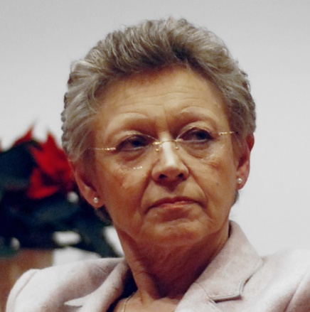
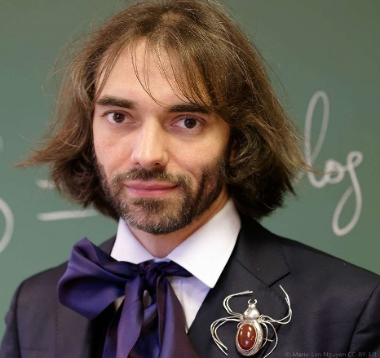
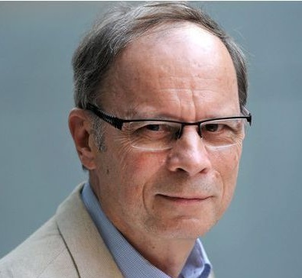
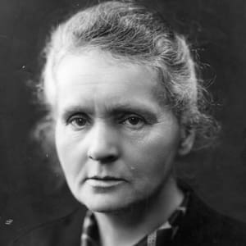
HIGH LEVEL
62 NOBEL PRIZES
RESEARCH
Françoise Barré-Sinoussi
Nobel Prize 2008, Medicine
Cedric Villani
Fields Medal 2010
Jean Tirole
Nobel Prize 2014, Economics
16 FIELDS MEDALS
Marie Curie
Nobel Prize 1903 and 1911

Slide 5
1
^{st}
TOURIST
DESTINATION
1,200
MUSEUMS
5,200
MOVIE THEATERS
4,500
CONCERTS
1,500
FESTIVALS

Slide 6
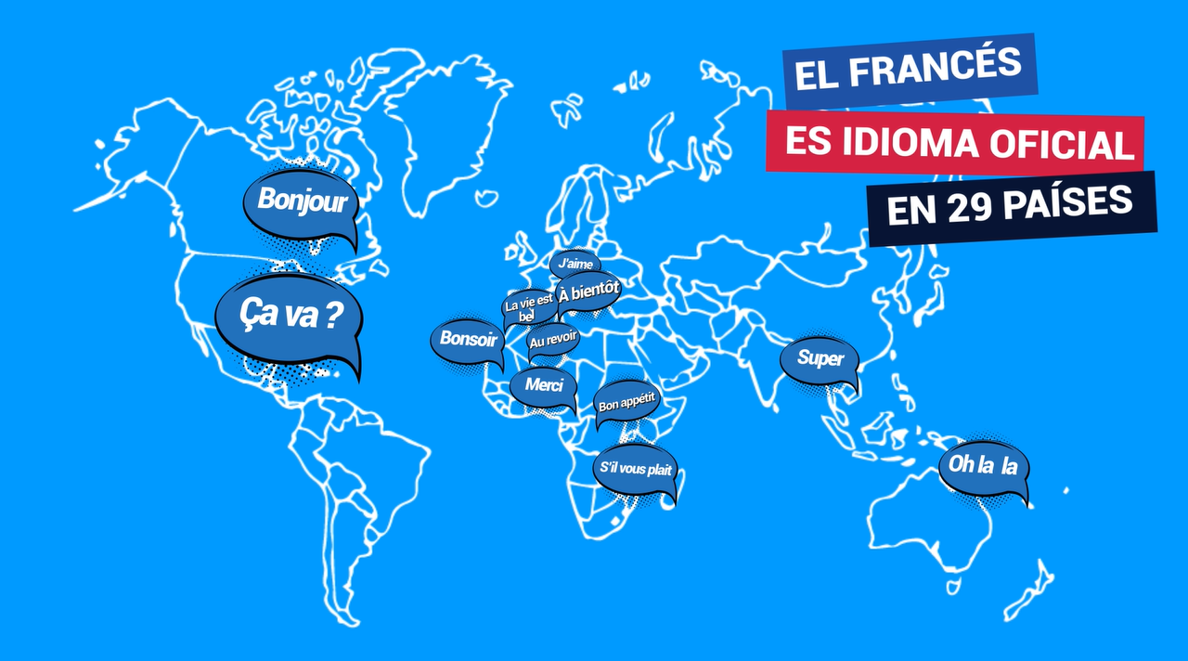
INTERNATIONAL
LANGUAGE
FRENCH
OFFICIAL LANGUAGE
IN 29 COUNTRIES

Slide 7
FRENCH
ECONOMIC
ATTRACTIVENESS

Slide 8
KEY FIGURES

Slide 9
STUDY ABROAD IN FRANCE
Experience French culture, expand your worldview, and establish lifelong affinity for international connections
Should we also talk about…
World’s best arts, music, food, wine
High quality education
Affordable and efficient healthcare system
Top tourist destination
325,000 international students studied in France last year

Slide 10
STUDY ABROAD IN FRANCE
17,500
American students studied in France last year
8,200
of them stayed in France more than 3 months
France is the 3rd most popular non-English study abroad destination for American students (after Italy and Spain)

Slide 11
COST

Slide 12
THE FRENCH GOVERNMENT
SUBSIDIZES ALL STUDENTS
(EVEN INTERNATIONAL ONES!)

Slide 13
DEGREES & TUITION FEES (per year)
THE FRENCH GOVERNMENT PAYS…
YOU PAY…

Slide 14
Cost of living per month | Paris | Rest of France
Housing (all charges included) | $800 | $500
Food | $350 | $300
Cultural and social activities | $150 | $100
Transportation | $50 | $40
TOTAL per month | $1,350 | $940
TOTAL per academic year (10 months) | $13,500 | $9,400

Slide 15
OPPORTUNITIES

Slide 16
HOW TO DO IT
Through a study abroad program
You obtain the American degree
For a summer, a semester or a year-long program
Directly enrolling in a French institution
You obtain the French degree
For a summer program, a Bachelor’s, Master’s or PhD

Slide 17
HOW TO DO IT
9 000 000
STUDENTS IN INTERNATIONAL MOBILITY IN 2025
TAPIF - Teaching Assistant Program in France
You teach English in France (and are paid)
Applications: October-November
Doing an internship
Full time
Between 15 days and 6 months (if longer than 2 months, you’ll be paid)

Slide 18
TOOLS
Short and summer programs
http://ecolesdete.campusfrance.org/
Programs taught in English
http://taughtie.campusfrance.org/
Bachelor and Master’s degrees
http://cataloguelm.campusfrance.org/
Research internships, PhD and PostDoc
https://doctorat.campusfrance.org/phd/offers

Slide 19
FUNDING

Slide 20
FOR STUDENTS
Benjamin Franklin
Generation Abroad Scholarships
Undergrad students planning to study abroad in France
$2,500 per student
Applications: June
TAPIF - Teaching Assistant Program in France
You teach English in France (and are paid)
Applications: October-November
1,200 paid teaching assistant positions per year

Slide 21
FOR STUDENTS
Recording of 360° videos by students in France to enable UC Davis students to explore France in virtual reality and inspire them to study abroad
UC Davis - Study Abroad Club
“Connections abroad”
Exploring France through virtual reality
France on Campus Award
For student organisations eager to launch a France-related project on campus
Up to $2,000 per project
Applications: October 26th
Lafayette Debates
A debate tournament in English
Winners receive a study trip to Paris to explore the debate topic

Slide 22
FOR RESEARCHERS
Chateaubriand fellowship
PhD students seeking to complete 4 to 8 months of research in France
$1,500/month + travel expenses
Deadline: January 15th
Fulbright US scholar program
US academics, university and college administrators
Applications: September
Thomas Jefferson fund
Collaborative research projects involving two young researchers
$20,000 per project
Applications: Spring
$600,000 distributed every year for Chateaubriand fellowships

Slide 23
FOR INSTITUTIONS
Transatlantic Mobility Program
Funding for initiating partnerships with French institutions
$20,000 per project
Deadline: May 15th
French for professional purposes
Annual training courses for university professors in French for professional purposes didactics
« Tournées » film festival
$2,200 to cover the cost of screening six French films
Deadline: Spring
400 students have benefited from the Transatlantic Mobility Program

Slide 24
TOOLS
Scholarships and grants for students
http://campusbourses.campusfrance.org/
Funding for institutions
http://frenchhighereducation.org/
Research internships, PhD and PostDoc
https://doctorat.campusfrance.org/phd/offers

Slide 25
CAMPUS FRANCE

Slide 26
WHO ARE WE
Campus France USA is a service provided by the French Embassy:
To help students who want to have an academic experience in France
To assist American institutions wishing to set up cooperation with French institutions
Campus France USA also coordinates the compulsory pre-visa application (for stays longer than 3 months)
15,000 American students are helped by Campus France every year

Slide 27
220 staff members in France
500 staff members
worldwide
250 local offices
in more than
120 countries
More than 190,000 alumni
on France Alumni
social network
Representing more than 350 French higher ed institutions
€130 million annual budget
More than
managed by Campus France
30,000 scholarships
YTÈUYI
Washington @ campusfrance.org
www.usa.campusfrance.org
More than 15,000 American students advised per year

Slide 28
MERCI

